Slide 1
Thimerosal
Kirsten Friberg
Joie Mazor
Daniel McClelland

Slide 2

Research Question
What does the literature demonstrate are the short term risk of Thimerosal, in vaccines and other daily use products?
Are there long term risks as well?

Slide 3
Learning objectives:
Define Thimerosal as a toxin
List a few examples of where Thimerosal is found
Identify the target organs and of injury from Thimerosal
Describe the pathway of elimination of Thimerosal
Define the prevalence and exposure of the general public to Thimerosal
Identify the management components that will help

Slide 4
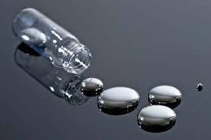
Thimerosal
Organomecury compound
Well established antispetic and antifungal
Well established as a preservative

Slide 5
The Specs
Formula: C9H9HgNaO2S
Density: 2.51 g/cm3
Molar Mass: 404.81 g/mol
Melting Point: 449.6 F
Water soluble
Characteristic odor, cream colored crystalline powder
pH: 6.7 pH
(2)http://en.wikipedia.org/wiki/Thimerosal

Slide 6
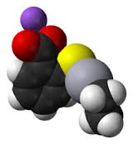
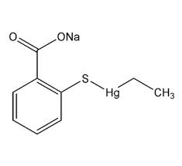
Structure
Thimerosal features mercury with a coordinating number 2 (two ligands are attached to Hg, the tholate and the ethyl group. The carboxylate group is not coordinated, but confers solubility in water.
Typically, organomercury thiolate compounds are prepared from organomercury chlorides.
(3) http://www.cdc.gov/vaccinesafety/Concerns/Thimerosal/Index.html

Slide 7
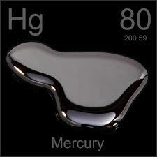

General effects of
Reduction in immune system function
Alters genetic and enzyme systems
Damages the nervous system, including coordination and the senses of touch, taste, and sight.
Methylmercury (not thimerosol) is particularly damaging to developing embryos, which are five to ten times more sensitive than adults. (USGS.gov)
The research is not available to correlate autism with thimerosol

Slide 8
Where is it?!
Introduced in the 1930s as a preservative in vaccinations and this is still its primary use.
There are some vaccines that have removed Thimerosal, but these still use the preservative:
Hep B
Recombivax HB
Hyper-Tet
Tetanus
Diptheria toxoid
(4). "Vaccines, Blood & Biologics." Thimerosal in Vaccines. N.p., n.d. http://www.fda.gov/biologicsbloodvaccines/safetyavailability/vaccinesafety/ucm096228#intro. 12 May 2014

Slide 9
Where else is it?
vaccines
immunoglobulin preparations
skin test antigens
antivenins,
cosmetics
ophthalmic and nasal products, and tattoo inks. (1)
(1) http://www.fda.gov/biologicsbloodvaccines/safetyavailability/vaccinesafety/ucm096228

Slide 10
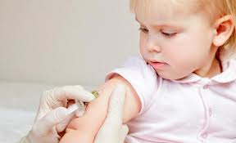
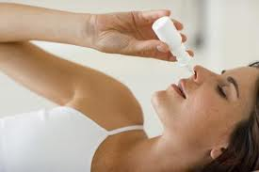


Slide 11
Other biological uses
Antitoxins
Flu shot – multi vials
Immune globulin prep
Skin prick test antigens.
Thimerosal is a preservative that kills the specified challenge organism and prevents growth of the challenge fungi, this is why it is an ideal preservative
(4) "Vaccines, Blood & Biologics." Thimerosal in Vaccines. N.p., n.d. http://www.fda.gov/biologicsbloodvaccines/safetyavailability/vaccinesafety/ucm096228#intro. 12 May 2014

Slide 12
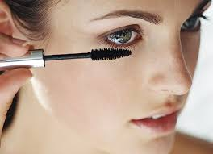
Cosmetic uses
Make-up removers
Eye moisturizer
Eye shadow
Mascara
Soap-free cleansers
(antibacterial)
Ear/eye/nose drops and ointments
Antiseptic sprays
Topical meds
Some first aid products
(5). "DermNet NZ." Thiomersal Allergy. N.p., n.d. http://dermnetnz.org/dermatitis/thiomersal-allergy.html. 12 May 2014
6) "CND: Common Sources of Ethylmercury." CND: Common Sources of Ethylmercury. N.p., n.d. http://www.anapsid.org/cnd/diffdx/mercurysources.html. 12 May 2014

Slide 13
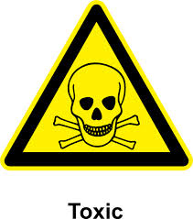
Toxicity
Thimerosal is very toxic by inhalation, ingestion, or in contact with skin
Very toxic to aquatic organisms and may cause long-term adverse effects in aquatic environments.
In the body, it is metabolized or degraded to ethylmercury (C2H5Hg) and thiosalicylate
(3)http://www.cdc.gov/vaccinesafety/Concerns/Thimerosal/Index.html

Slide 14
Toxicity
Animal experiments suggest that Thimerosal rapidly dissociates to release ethylmercury after injection (8)
The disposition patterns of mercury are similar to those after exposure to equivalent doses of ethymlmercury choloride (8)
The CNS and the kidneys are targets, with lack of motor coordination being a common sign
The mechanisms of toxic action are unknown (8)
(8). http://pubchem.ncbi.nlm.nih.gov/summary/summary.cgi?cid=16684434

Slide 15
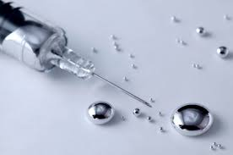
Elimination
Thimerosal accumulates within the tissues of the body.
Different types of Mercury store in different types of tissues
Mercury testing measures the exposure level (fish, dental fillings) and excretion ability (body’s ability to get rid of each kind)

Slide 16
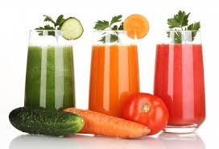
Glutathione Super System
Natural detoxification system
If the body is working the way it should, glutathione works with enzymes, antioxidants and transport proteins to bind to the heavy metals, effectively detoxing the system.

Slide 17
Why isn’t the super-system enough?
Factors that inhibit the system:
Age
Impaired genes
Poor diet
Toxic exposure/environment
Stressed and weakened system

Slide 18
Starting a Mercury detox
Work with someone who is trained in heavy-metal detoxing, as it can be dangerous if done in the wrong way, or too quickly
Remember, it can take years to eliminate Mercury from the body, so do research before you start

Slide 19
How to Detox
Start by eliminating inflammatory foods
Sugar
Fast food
Starch/grain
Boost glutathione production and mobilize mercury
Boost enzymes and transport proteins with super foods
Garlic, sulfur, heritage, sodium R-liopic acid,whey, lumbrokinaese, pine bark extract
Make sure excretion routes are open to avoid a heavy metal build-up within the system.
9. Mercola, Joseph. "Revised Protocol to Detoxify Your Body from Mercury Exposure." Mercola.com. N.p., 13 Jan. 2013. Web. 13 May 2014. <http://articles.mercola.com/sites/articles/archive/2013/01/13/mercury-detoxification-protocol.aspx>

Slide 20
Half life of methlymercury & ethylmercury
According to the World Health Organization, “The half-life of ethylmercury is short (less than one week) compared to methylmercury (1.5 months) making exposure to ethylmercury in blood comparatively brief. (WHO | Statement on Thimerosal [Internet]. [cited 2014 May 7]. Available from: http://www.who.int/vaccine_safety/committee/topics/thiomersal/statement_jul2006/en/)
Ethylmercury has been found to be less dangerous, meanwhile it moves freely throughout the human body, and has at least a 120 days half life in the adult brain. (The toxicology of mercury and its chemical ... [Crit Rev Toxicol. 2006] - PubMed - NCBI [Internet]. [cited 2014 May 8]. Available from: http://www.ncbi.nlm.nih.gov/pubmed/16973445)

Slide 21
Half life of methlymercury & ethylmercury
Children:
Ethylmercury and methylmercury cross the blood-brain barrier as well as the placenta.
Methlymercury becomes reduced to the less harmful ethylmercury in the system
Ethylmercury does not reduce to another form. It remains isolated and hopefully for the individual is excreted via the gut.
Increased yeast, a natural chelator, is often associated with heavy metal poisoning/toxicity, as the body’s natural strategies attempt to excrete Thimerosal

Slide 22
Excretion
Ethylmercury is actively excreted via the gut unlike methylmercury, that which is not converted, accumulates in the body.
In infants post thimerosol vaccine dose, it is excreted in high amounts in the stool.
This means that it ends up in our sewage waste, which is processed into the bay and the ocean where we live.
And then what do you think happens…?

Slide 23
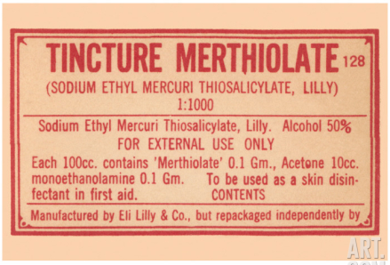
Exposure risks
Thimerosal is a common ingredient in vaccines, nasal sprays, antiseptics, antifungals, eye drops and red tattoo inks.

Slide 24
Public Prevalence
If you received a round of vaccines in America before 2003, you most likely have been exposed to thimerosol/ethylmercury, and potentially your system is still dealing with the aftermath of trying to excrete it. If your system has been stressed by the 3 t’s (thoughts, traumas, or additional toxins) you might very well still be working on detoxing mercury from your body.
The FDA banned the use of this chemical in over-the-counter products in the late 1900s, and has a list of known possible side effects of poisoning.
Notes:
(November 5, 1999 was when the FDA working concurrently with the CDC had removed Thimerosal entirely from vaccine ingredients),

Slide 25
Public Prevalence
You can still purchase a tincture form of antiseptic under a trade name Merthiolate, however most products currently have “Mercury Free” disclosure on the bottles.
Another trade name for similar topical antiseptic products is Mercurochrome.

Slide 26
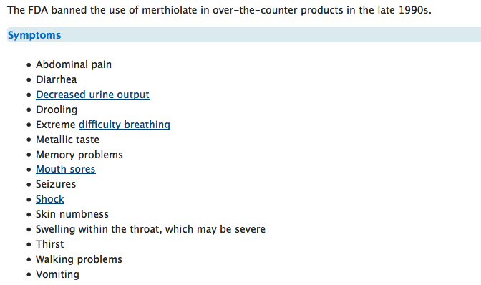
Merthiolate poisoning: MedlinePlus Medical Encyclopedia [Internet]. [cited 2014 May 8]. Available from: http://www.nlm.nih.gov/medlineplus/ency/article/002678.htm

Slide 27
Public Prevalence
Still being used in scientific studies. As a preservative, in very small amounts, stabilizing microbes as scientists attempt to isolate and learn more about our natural world.
(Thimerosal - U.S. Geological Survey Search Results [Internet]. [cited 2014 May 8]. Available from: http://search.usa.gov/search?affiliate=usgs&utf8=%E2%9C%93&query=thimerosol&commit=Search )
In any case, it is still being used and produced. And thus, we have to wonder how it enters our environment, as a waste product. In industrial areas, methylmercury levels can be higher than life can sustain, and causes mutations and disease in every level of the food chain, and thus the entirety of the ecosystem. (Minimata, Japan)
This is where we need more research to discern the short and longer term effects and outcomes of having these levels of Thimerosol in various forms of mercury in our water, soil, and food supply

Slide 28
Our Future Needs of Research
We know that there Is an accumulation of mercury in various forms in our environment
What long term levels are toxic in our bodies and our environment?
What is the importance of studying environmental build-up of thimerosol?
How do we effectively deal with environmental toxicity?

Slide 29
What to know for your future
Know ingredients of the products you use
Question your health care providers about vaccine preservatives in vaccines and anti-virals is multi use vials of flu shots
Monterey Bay Seafood Watch
As a practitioner, find out who near you is well trained to provide slow and effective detoxification

